Slide 1
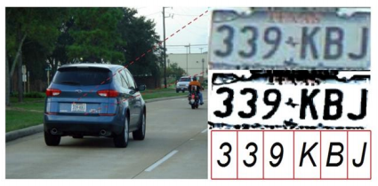
Optical Character Recognition (OCR)

Slide 2
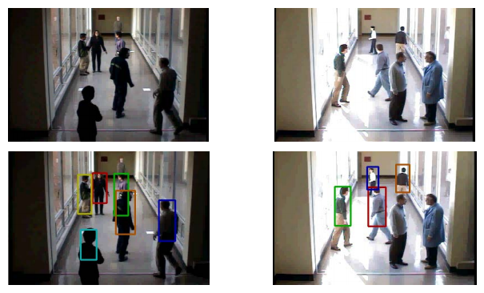
Surveillance and Security

Slide 3
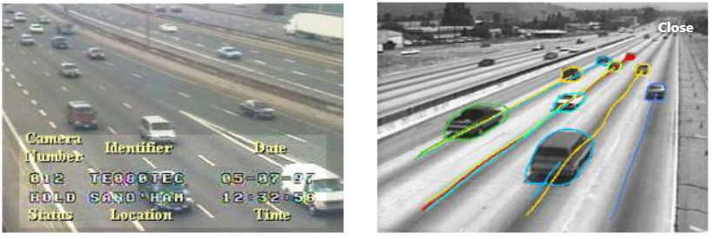
Traffic Monitoring

Slide 4
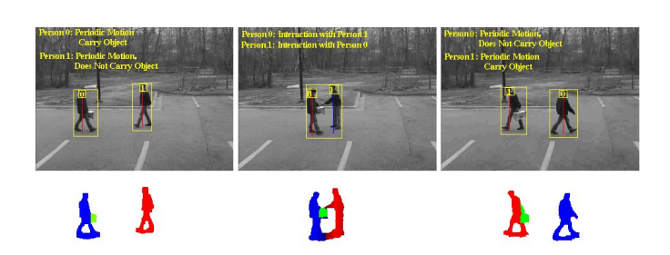
Activity Recognition

Slide 5
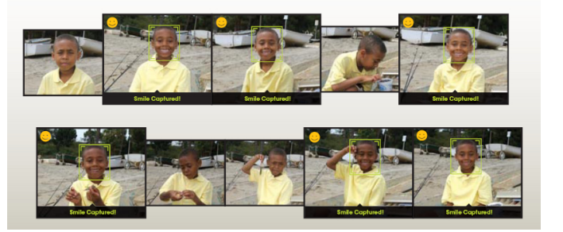
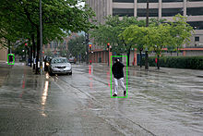
Emotion Detection
Pedestrian Tracking

Slide 6

Face Recognition

Slide 7
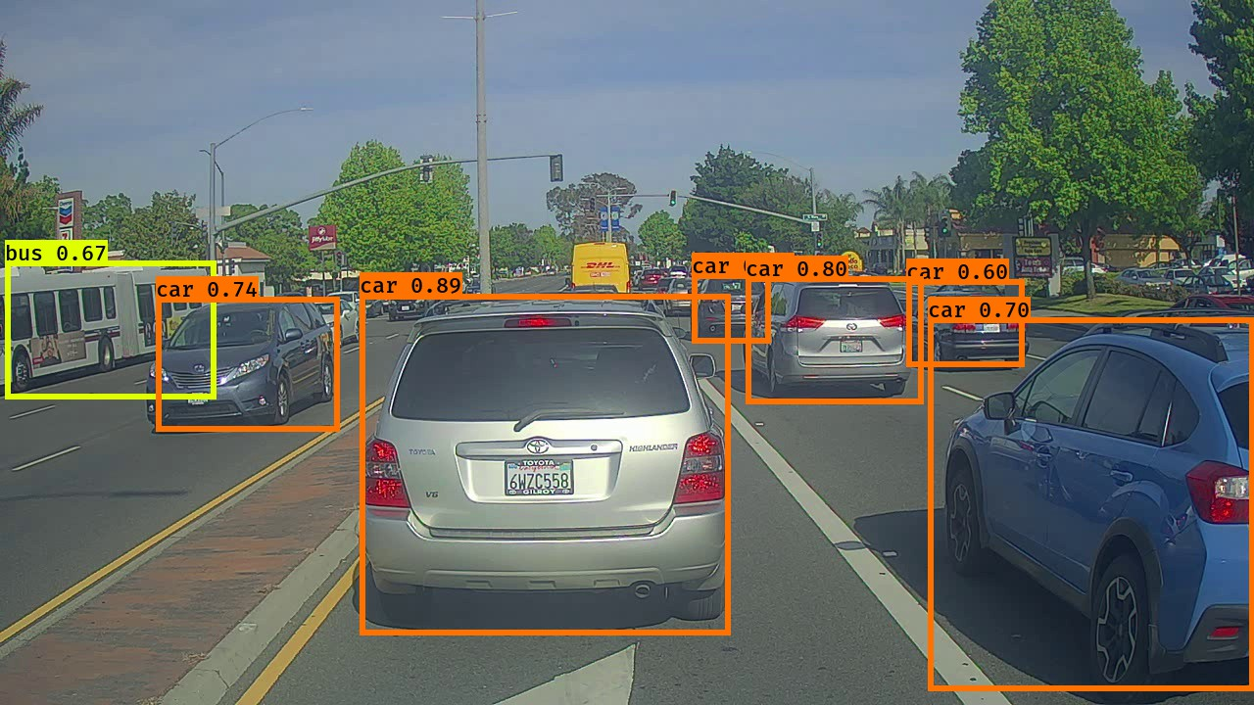
Autonomous Driving

Slide 8
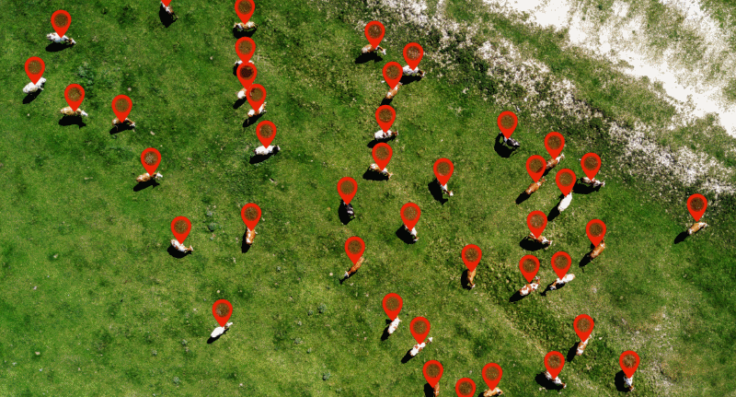
Counting
Objects

Slide 9
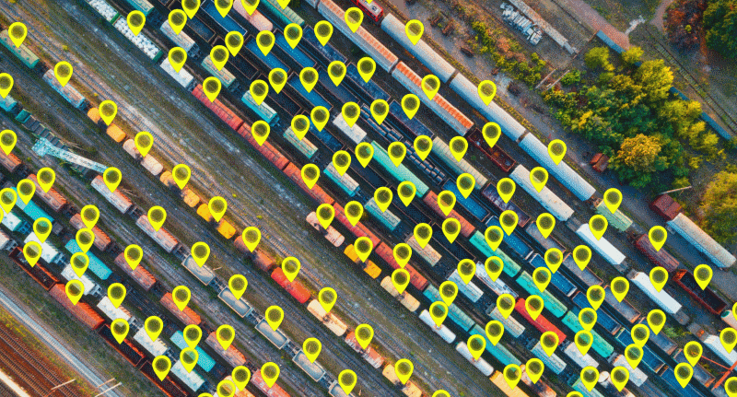
Container
Tracking

